Slide 1
OJT REPORT
FOR CG DEVELOPMENT
Reporter : Mao Zhengjun(毛正军)
Instructor: Liu Bing
Division : RDB-S21
2018/3/16

Slide 2
agenda
Introduction
Schedule
Working Contents
Harvest
Goals And Plan

Slide 3

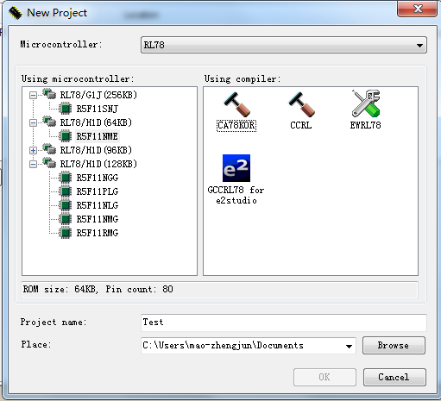
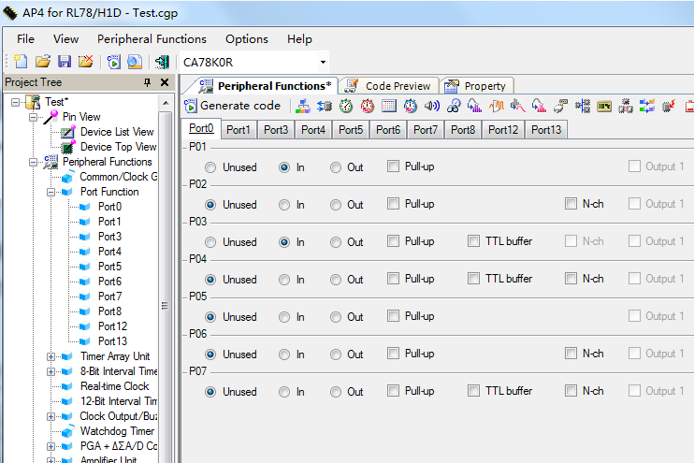
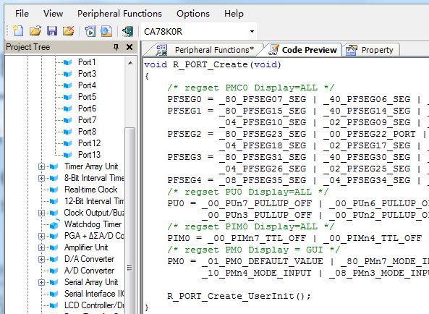
Introduction
What is the Code Generator
Code Generator is a software for generating driver code automatically by simple and convenient graphical interface configuration.
How to use it
Select device
Configure peripherals
Generate driver code

Slide 4
agenda
Introduce
Schedule
Work Report
Harvest
Plan And Goals

Slide 5
Schedule
2017 |  |  |  |  |  | 2018
July | Aug | Sept | Oct | Nov | Dec | Jan | Feb | Mar
CG development for RL78H1D
CG development for RL78G1J
Maintenance
No. | Peripherals
1 | CGC
2 | TAU
3 | 8BITIT
4 | RTC
5 | 12BITIT
6 | TMRJ
7 | SMOTD
8 | EXSD
9 | PCLBUZ
10 | WDT
11 | PGA_DSAD
12 | AMP
13 | DA
14 | AD
15 | IICA
16 | UARTMG
… | …
No. | Peripherals
1 | CGC
2 | WDT
3 | CMP
4 | AD
5 | DA
6 | PORT
7 | TAU
8 | RTC
9 | 12BITIT
10 | TMRJ
11 | TMRD
12 | TMRG
13 | PCLBUZ
14 | SAU
15 | RF
16 | IICA
… | …
No. | Ticket
1 | #2446
2 | IDE17308
3 | #1897
4 | #2429
5 | IDE18629
6 | IDE17833
… | …
My tasks

Slide 6
agenda
Introduction
Schedule
Work Report
Harvest
Plan And Goals

Slide 7
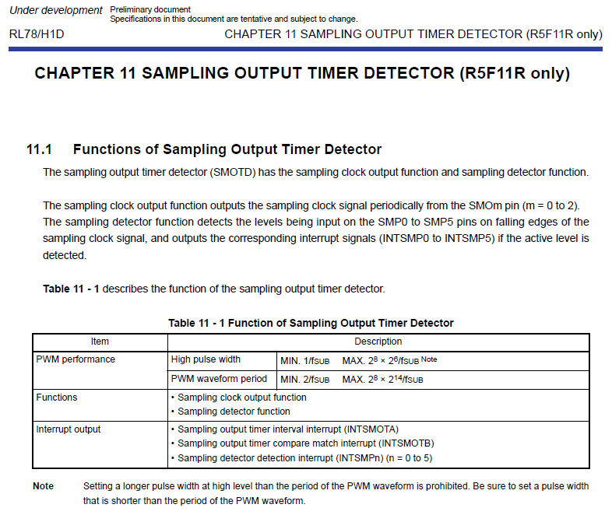
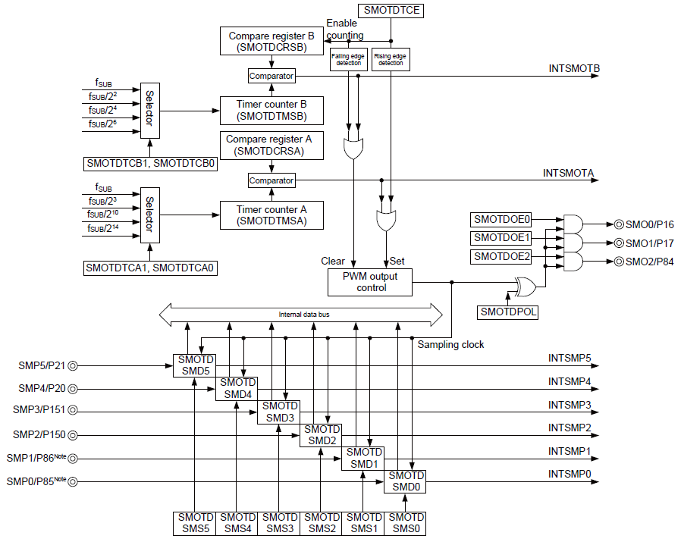
WORKS-Achievements
Manual learning
Detailed design
Coding
Test
User’s Manual
Block diagram of peripherals

Slide 8
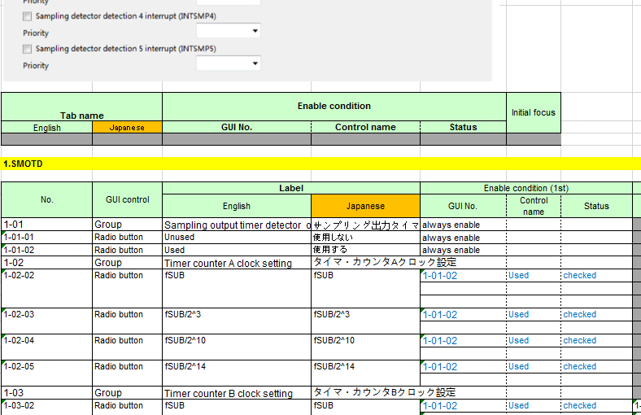
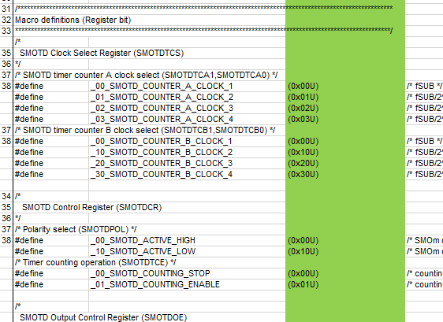
WORKS-Achievements
Manual learning
Detailed design
Coding
Test
GUI detailed design
Project | Task
RL78H1D | 8BITIT
 | SMOTD
 | WDT
 | PGA_DSAD
RL78G1J | WDT
 | CMP
 | AD
 | DA
Code detailed design
Independent design

Slide 9
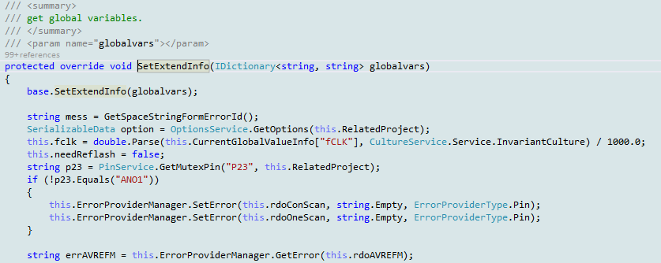
WORKS-Achievements
Manual learning
Detailed design
Coding
Test
☆ :Normal
☆☆:Hard
Project | Task | Achievement（The amount of code） |  |  |  | Difficulty
 |  | New (L) | Modify (L) | Reuse (L) | Total (L)
RL78H1D | 8BITIT | 105 | 228 | 1704 | 2037 | ☆☆
 | SMOTD | 2702 | 0 | 0 | 2702 | ☆☆
 | WDT | 0 | 89 | 800 | 889 | ☆
 | PGA_DSAD | 1224 | 1794 | 597 | 3615 | ☆☆
RL78G1J | AD | 500 | 1300 | 4900 | 6700 | ☆☆
 | DA | 200 | 500 | 1100 | 1800 | ☆☆
 | CMP | 800 | 1000 | 1600 | 3400 | ☆☆
 | WDT | 10 | 30 | 890 | 930 | ☆
Independent coding

Slide 10
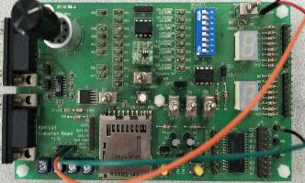
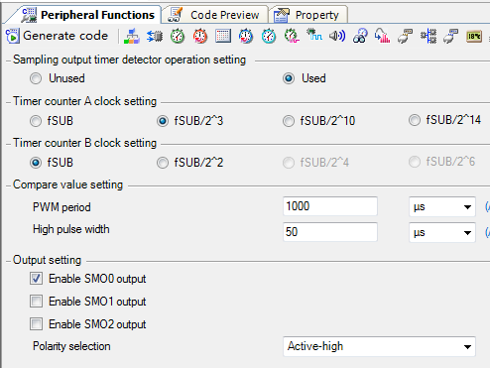
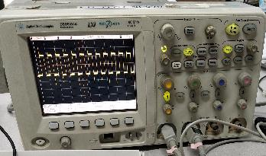
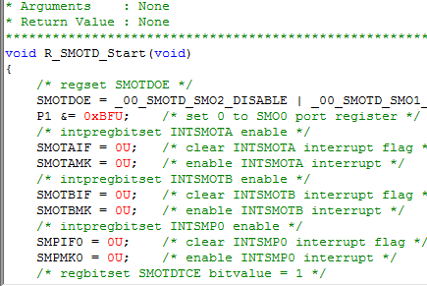
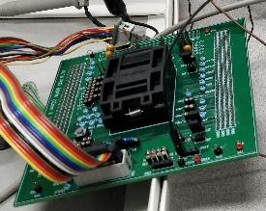
WORKS-Achievements
Manual learning
Detailed design
Coding
Test
SMOTD module
③
Input signal
①
Generate driver code
②
Download to chip
④
Output signal

Slide 11
agenda
Introduction
Schedule
Work Report
Achievement
Plan And Goals

Slide 12

Achievement
Technique Skills
CG Development |  | Debug/Hardware test
before | After ↑↑ | before | After ↑
a little experience | can work independently | no experience | can work skillfully
Work Ability
Work independently |  | Work efficiency
before | After ↑↑ | before | After ↑↑
no experience | can work independently | no experience | can complete tasks on schedule with good quality

Slide 13
agenda
Introduction
Schedule
Work Report
Achievement
Plan And Goals

Slide 14
plan and goals
Short term plans
Learn plug-in development technology based on eclipse for future development
Learn principle of complex peripherals
Such as : Timer Array Unit, Serial Array Unit
Long term goals
Strive to create first-class products
3 years
2 years
Can develop some sample frameworks and core code.
1 years
Can independently develop highly difficult modules.
Can independently develop medium difficuty modules.

Slide 15
Thank you!

Slide 16
Renesas.com

Slide 17
Q&A

